Slide 1



JDBC
www.cybage.com
Copyright © 2019 Cybage Software Pvt. Ltd. All Rights Reserved. Cybage Confidential. www.cybage.com

Slide 2
Agenda
Why JDBC ?
What is JDBC ?
Driver Types in JDBC
Basic Steps in Using JDBC
JDBC Architecture
www.cybage.com

Slide 3
RDBMS
Relational Database:
A database is a means of storing information in such a way that
information can be retrieved from it easily.
In simplest terms, a relational database is one that presents information in
tables with rows and columns.
From your Java Application you may need to communicate with the database (..to access / modify data etc.)
Typical Activities your application may need to carry out are:
- Connect to a data source, like a database
Send queries and update statements to the database
Retrieve and process the results received from the database
-
-
www.cybage.com

Slide 4
Why JDBC
The need for JDBC :
All databases support SQL (ANSI SQL)
Different database vendors have introduced their proprietary SQL
constructs
Different database vendors have introduced Application Programming
Interfaces for accessing data stored in their respective databases
Drawback: ?
If the database changes, all data access logic has to be entirely
rewritten. ( ‘ Data access code’ should remain same irrespective of
the Database Vendor)
A need was felt to access data from different databases in a
consistent and reliable way
www.cybage.com

Slide 5
What is JDBC
It is not an acronym, but is called Java Database Connectivity
It is a vendor independent API drafted by Sun to access data from different databases in a consistent and reliable way
JDBC provides an API by hiding the vendor specific API by introducing the concept of a JDBC driver between the application and the database API
Hence, JDBC requires a vendor specific driver
The JDBC driver converts the JDBC API calls from the Java application to the DB vendor specific API calls
www.cybage.com

Slide 6
JDBC API
Driver
DB1
J D
B C
A P I
Driver
DB2
Java Application
Driver
DB3
www.cybage.com

Slide 7
JDBC API
The JDBC™ API provides programmatic access to relational data from the Java™ programming language.
Using the JDBC API, applications can execute SQL statements, retrieve results, and propagate changes back to an underlying data source.
•
The JDBC API can also interact with multiple data sources in a
distributed, heterogeneous environment.
www.cybage.com

Slide 8
Driver Types in JDBC
There are 4 types of JDBC drivers
Type 1 : JDBC – ODBC Bridge
Type 2 : Native API – Partly Java Driver
Type 3 : Java – Net Protocol Driver
Type 4 : All Java Driver
www.cybage.com

Slide 9
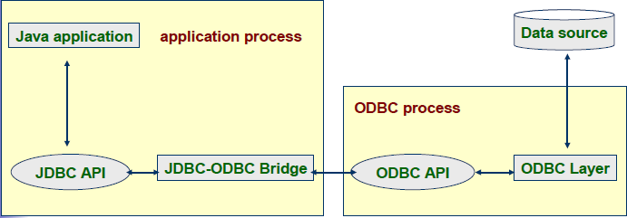
JDBC- ODBC Bridge Driver - Type 1
Slow performance driver
Used for Proto-typing purposes only
Inherits limitations of ODBC implementations
www.cybage.com

Slide 10
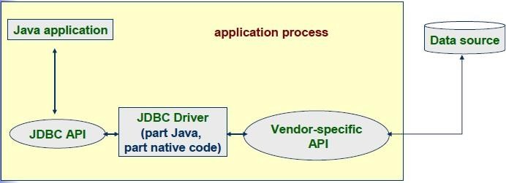
Native API – Partly Java Driver – Type 2
Partly java-partly written in native language
Native libraries required to be installed on client system
3.
Uses native C lib calls for conversion
www.cybage.com

Slide 11
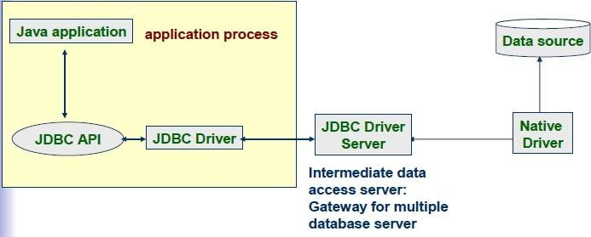
Java-Net Protocol Driver –Type 3
Net protocol driver
JDBC calls are passed through the network to the middle tier server
The middle tier server then translates the requests to database specific native connectivity interface to further request to the database server
Deployment is simpler & flexible
www.cybage.com

Slide 12
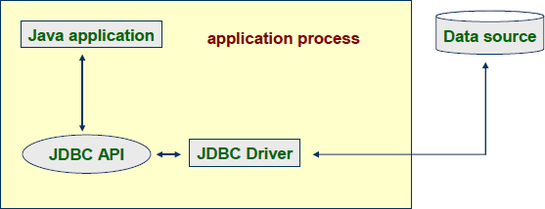
All Java Driver – Type 4
Is a pure Java driver
Converts JDBC calls to vendor specific database management system protocol
client applications can directly communicate with the database server
Also known as thin driver & performance is very good
usually comes from DB vendor
www.cybage.com

Slide 13
Basic Steps In Using JDBC
Load the driver
Define the connection URL
Establish the database connection
Create a statement object
Execute query
Process results
Close database connection
www.cybage.com

Slide 14
JDBC Architecture
ResultSet
Java Application
Statement
Connection
Driver Manger
Oracle Driver
Jdbc-odbc
Odbc Driver
Oracle
www.cybage.com

Slide 15
JDBC Architecture
JDBC Interfaces
Driver
Connection
Statement
PreparedStatement
CallableStatement
DatabaseMetadata
ResultSet
ResultSetMetadata
JDBC classes
Date
DriverManager
Time
TimeStamp
Types
www.cybage.com

Slide 16
Driver Manager
The DriverManager class is the traditional management layer of JDBC, working between the user and the drivers.
It keeps track of the drivers that are available and handles establishing a connection between a database and the appropriate driver.
In addition, the DriverManager class attends to things like driver login time limits and the printing of log and tracing messages.
It is possible that an application may need to interact with multiple databases created by different vendors
The JDBC Driver Manager provides the ability to communicate with multiple databases and keep track of which driver is needed for which database
www.cybage.com

Slide 17
Statement
Methods in Statement interface:
Statement
PreparedStatement
CallableStatement
boolean execute(String sql)
Resultset executeQuery()
int executeUpdate()
CallableStatement
www.cybage.com

Slide 18
Using Statement
The Statament object is used to execute SQL queries against the database.
There are 3 types of Statament objects :
Statement :
For executing simple SQL statements
PreparedStatement
For executing pre-compiled SQL statements
CallableStatament
-For executing database stored procedures
www.cybage.com

Slide 19

www.cybage.com

Slide 20
Thank You!
Any Questions ?
www.cybage.com
Copyright © 2019 Cybage Software Pvt. Ltd. All Rights Reserved. Cybage Confidential._{6/4/2021} www.cybage.com 20

